Slide 1
CSE-3213
Computer Graphics Lecture 18 3D Transformation

Slide 2
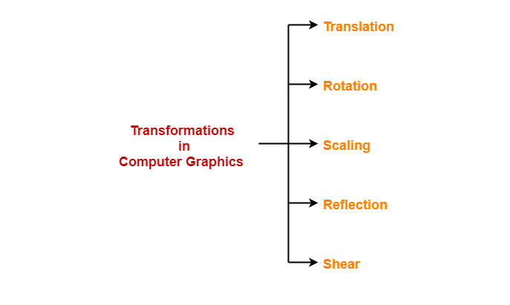
3D Transformation

Slide 3
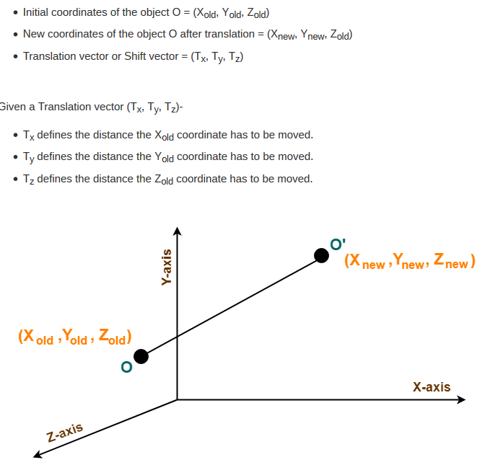
3D Translation

Slide 4
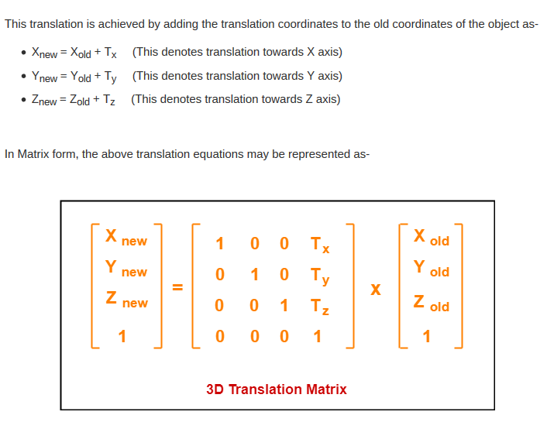
3D Translation

Slide 5
3D Translation
Given a 3D object with coordinate points A(0, 3, 1), B(3, 3, 2), C(3, 0, 0), D(0, 0, 0). Apply the translation with the distance 1 towards X axis, 1 towards Y axis and 2 towards Z axis and obtain the new coordinates of the object.

